Slide 2
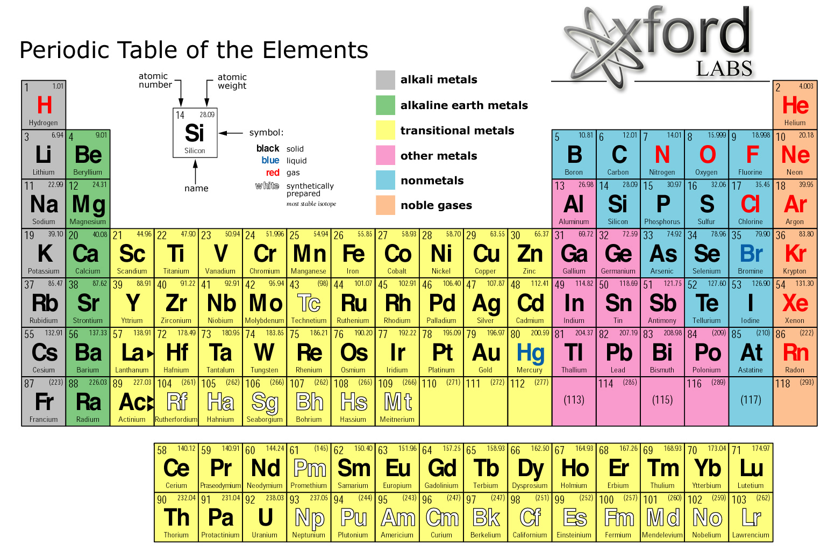
Organic Chemistry
Atoms are the smallest unit that make up the chemical elements. Things that we can see and feel around us are made up of atoms.

Slide 3
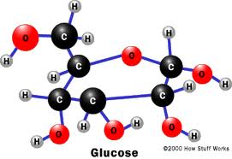
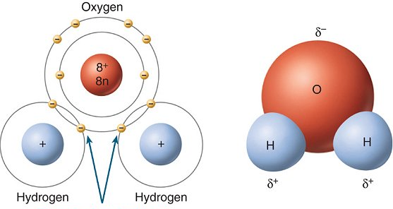
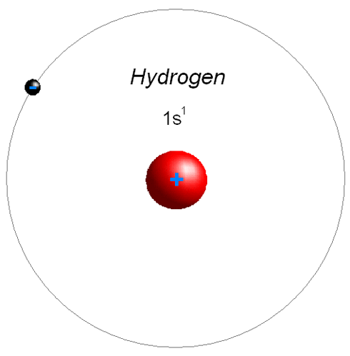
Organic Chemistry
Atoms can get lonely…
A molecule is created when two or more atoms meet and chemically bond together.
Examples: H₂ (hydrogen), O₂ (oxygen), O₃ (ozone)
A molecule can be called a compound if it has at least 2 different kinds of atoms that meet and chemically bond together.
Examples: H₂O (water), CO₂ (carbon dioxide)
Glucose/Sugar Molecule
Compound
Single Atom
Water Molecule Compound

Slide 4
Organic Chemistry
Organic compounds always have carbon plus a few other elements like hydrogen, oxygen, and nitrogen, phosphorus, or sulfur.
Carbon
Hydrogen
Oxygen
Nitrogen
-
Phosphorous
‘
Sulfur

